Slide 1
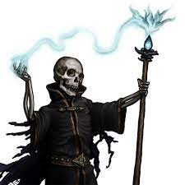
The Night of the Liche
Pitch Date: 12/18/2022 Update 2/5/2023
Release Date: 4/9/2023 135 Commits (+12)
Team Lead: Vince McKeown 10 Contributors (+1)
1
2
3
4
5
6
7
8
9
10
11
12
13
14
15
16

Slide 2
Vince McKeown
Coding
Continued work on Player Card
Findable objects / Gravestone

Slide 3
Tylor Allison
Coded animated objects

Slide 4

H Trayford
Graveyard creation work.
Level Design / Gravestone

Slide 5
Christer “McFunkyPants” Kaitila
Enhanced the darkness and lighting effects
Light bounces around fireplace / candles

Slide 6
Carsair
Practice Commit
Removed Favicon

